Slide 1
Thulani Langa
OT Network Engineering Department

Slide 2
Agenda
01-BackGround
02-Tasks Completed
03-The future

Slide 3

Background
Who me is?

Slide 4
Thulani Langa
Studied IT Engineering at iStudent Academy (Networking and Software Development)
I like animals
I don’t know what else to say…

Slide 5
Tasks Completed
UNLOCKING NEW HORIZONS

Slide 6
Tasks & Side Projects
01-Switch Configuration
02-Setting up a industrial switch
03-Adding a server to a network
03.5-Firewall Configuration (To be continued)
04-Home Assistant
05-Setting up a thin client
06-Raspberry Pi Configuration
07-Setting up a Access Point
08-Switch Configuration
09-Server Diagnoses
10-Mapping Out The Hulamin OT Network
Driller Bill (Cisco IOS Simulator + Drill Exercises for Cisco Commands)
Spinning Jenny
Holly Bibley (Network Visualizer)

Slide 7
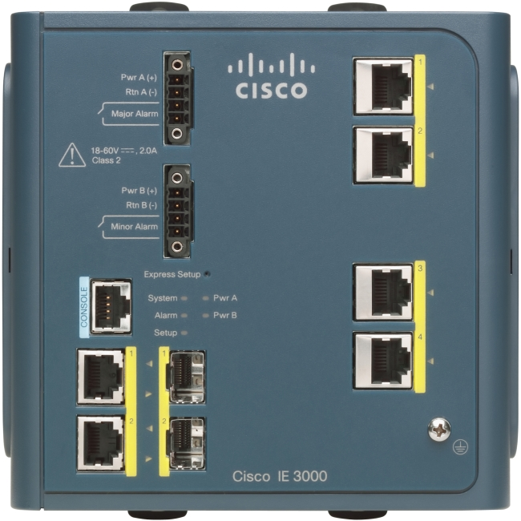
01-Switch_Configuration
For my first task was given a switch (Cisco Catalyst IE-3300 Rugged Switch IE-3300-8T2S-E) to practice getting used to Cisco CLI commands
I did the following drill exercises:
01 — Boot Process & Password Recovery
02 — Factory Reset & Flash Cleanup
03 — IOS Image & Flash Management
04 — Backup, Restore & Config Rollback
05 — Basic Management Setup (Real SSH)
06 — Interface Troubleshooting & Err-Disabled Recovery
07 — VLANs & Access Ports
08 — Trunking & Native VLANs
09 — EtherChannel & LACP
10 — Port Security Fundamentals
11 — Spanning Tree (PortFast & BPDU Guard)
12 — VTP & the Revision Number Trap
13 — Inter-VLAN Routing (SVI & Router-on-a-Stick)
14 — CDP & LLDP Neighbor Discovery
15 — DHCP Snooping & Dynamic ARP Inspection

Slide 8
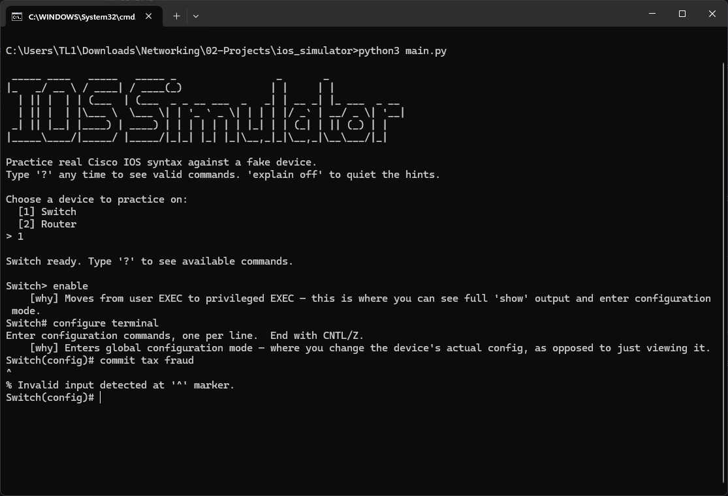
Driller Bill
When I was first starting out with the switch configuration task, it was fine when I was at work, but when I got home that was a different issue, I couldn’t exactly bring the switch with me, and opening Packet Tracer and going through that whole process specifically practice CLI commands was a bit verbose. So I decided to make my own fake CLI.
Driller Bill is a fake Cisco IOS CLI for practicing real switch/router syntax — no lab hardware, no GNS3, no packet tracer license needed. Type real Cisco commands, get real Cisco-style prompts, output, and errors. It ran on the terminal and was a almost perfect copy.
Or at least that was the initial program…

Slide 9

⚠️WARNING⚠️
This slide contains explicit mentions of AI—viewer discretion, severe eye-rolling, and deep existential groaning are strongly advised for all proud AI haters.

Slide 10
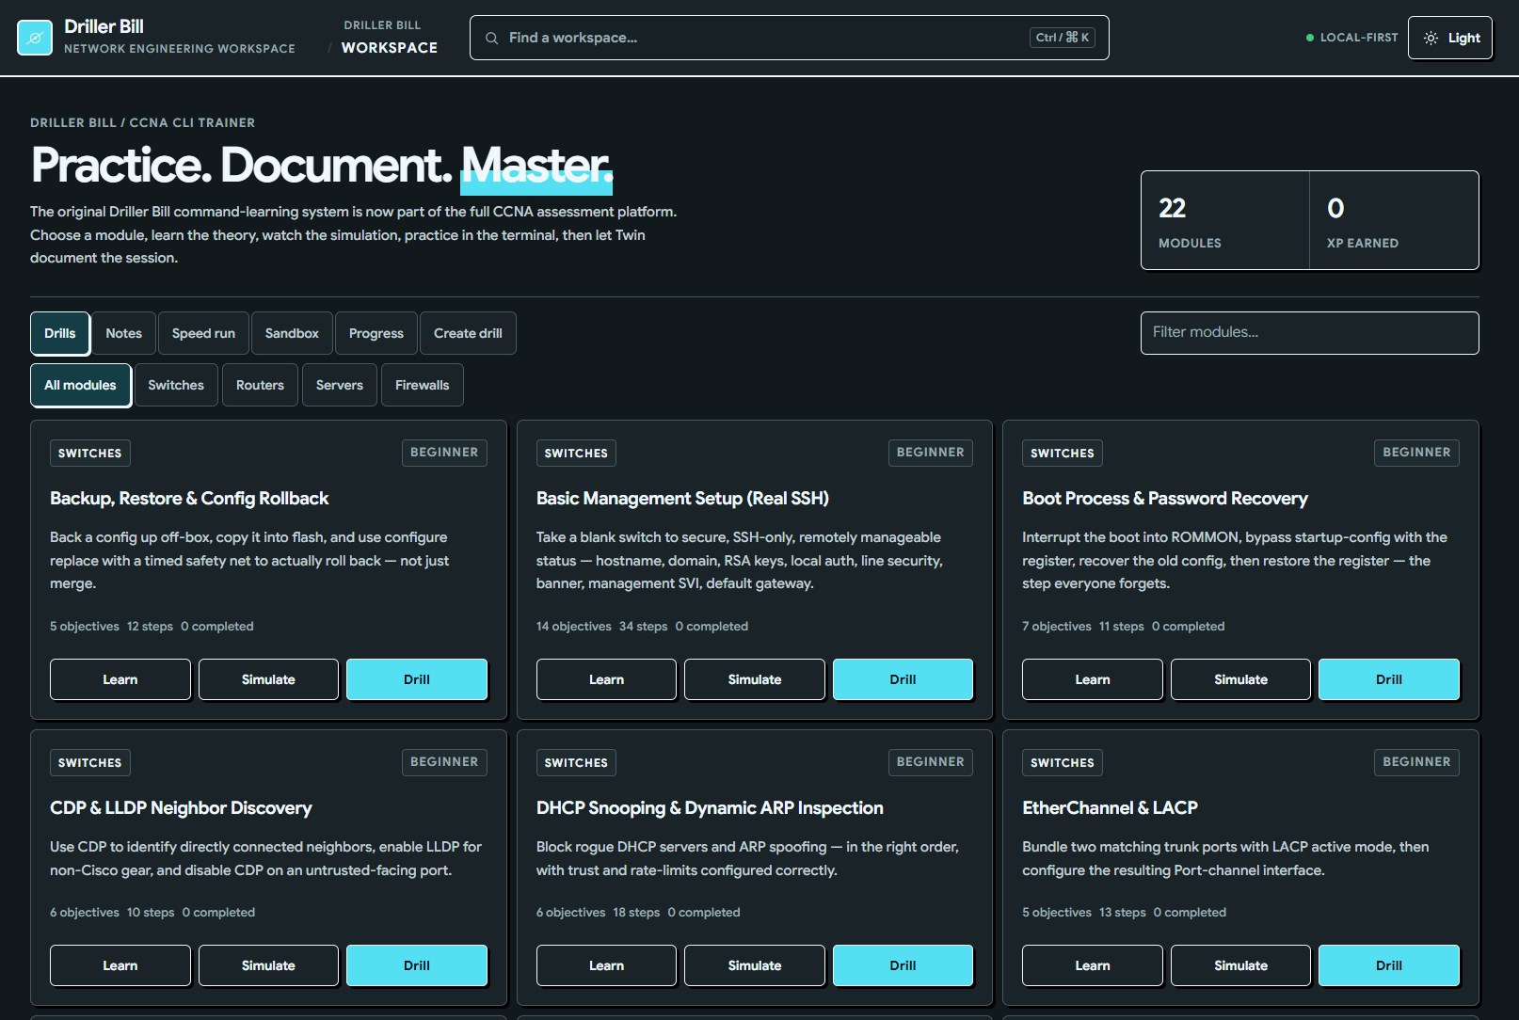
Driller Bill: AI enhancement 1
At first I simply wanted to somehow incorporate my drill exercises into the CLI, so I can choose a drill, and complete the exercise by following the steps.
But I ended added a lot more. I now have a GUI for Driller Bill and I can choose to:
Learn – Where you’re taught the concept and what they are.
Simulate – Where you watch the program execute the commands in real-time
Drill – Where you can now do the drill yourself.

Slide 11
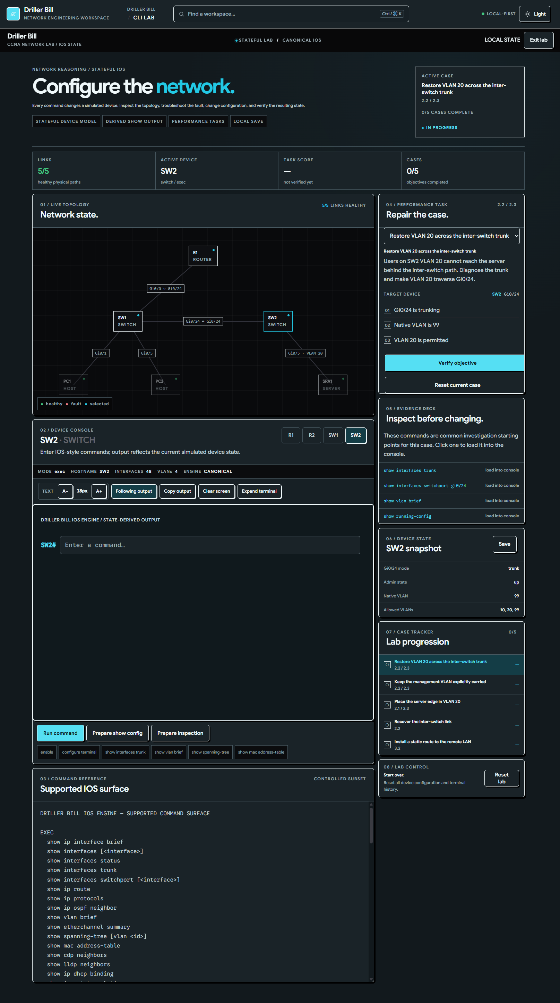
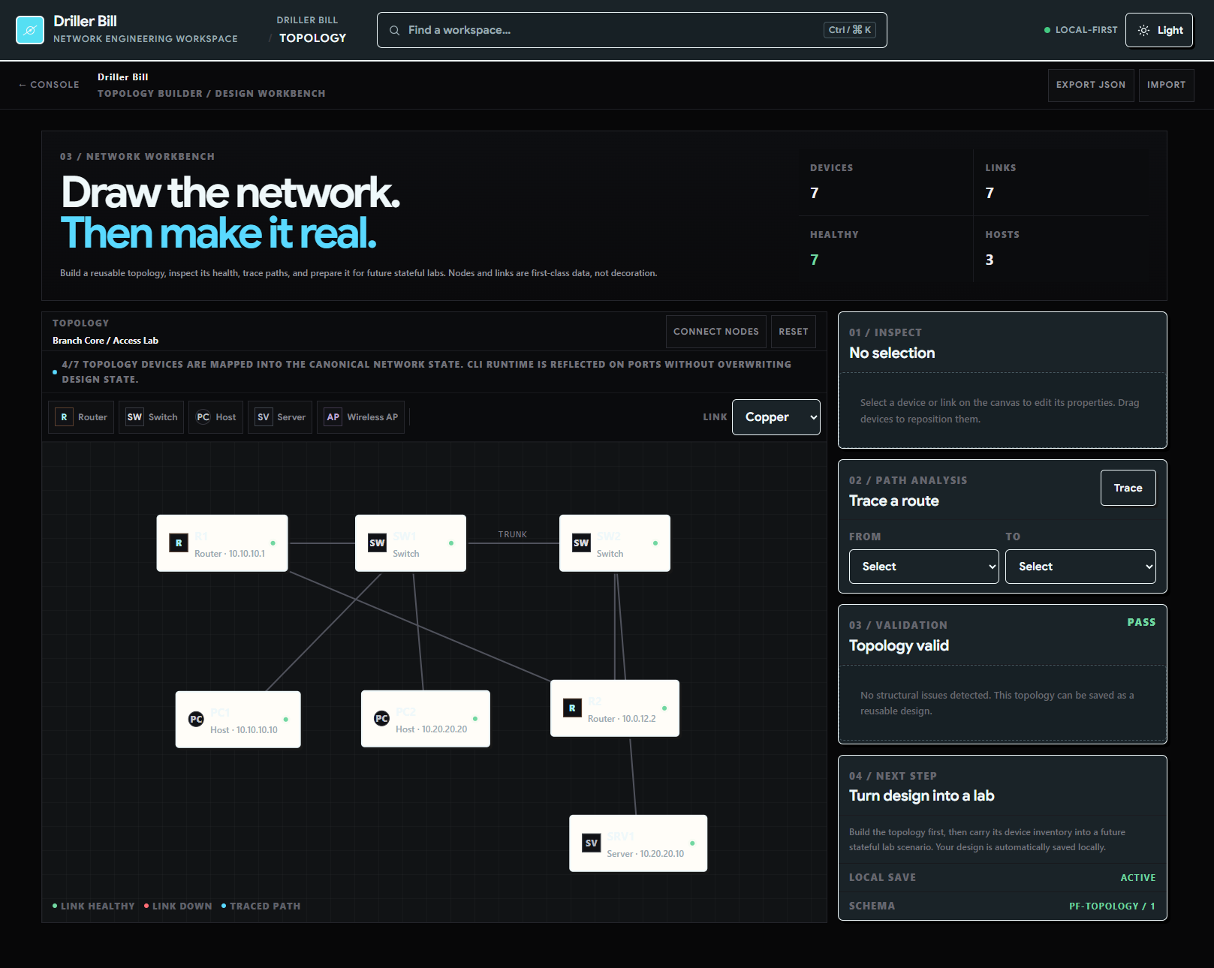
Driller Bill:
AI Enhancement 2
The CLI now has a GUI, and I can even simulate a simple network without having to use packet tracker.

Slide 12
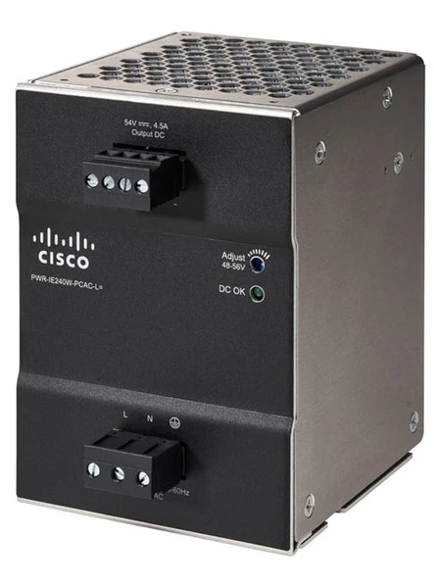
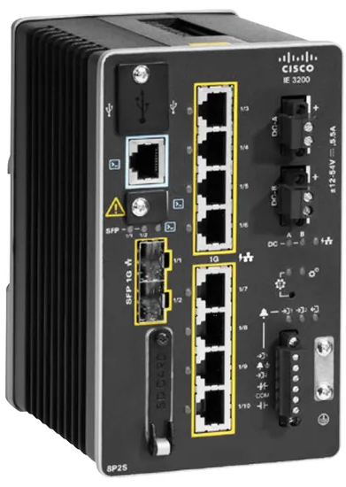
02-Setting_Up_A_Industrial_Switch
My second task was setting up a switch (Cisco Catalyst IE-3300 Switch and a PWR-IE240W-PCAC-L Power Supply)
I made notes on essential theory and decided to follow the same format and principle: Learn at least a general amount of how everything you're working with works.
This task included having to install the switch, verify the boot-up sequence, configure it, and connect the switch to other devices.

Slide 13
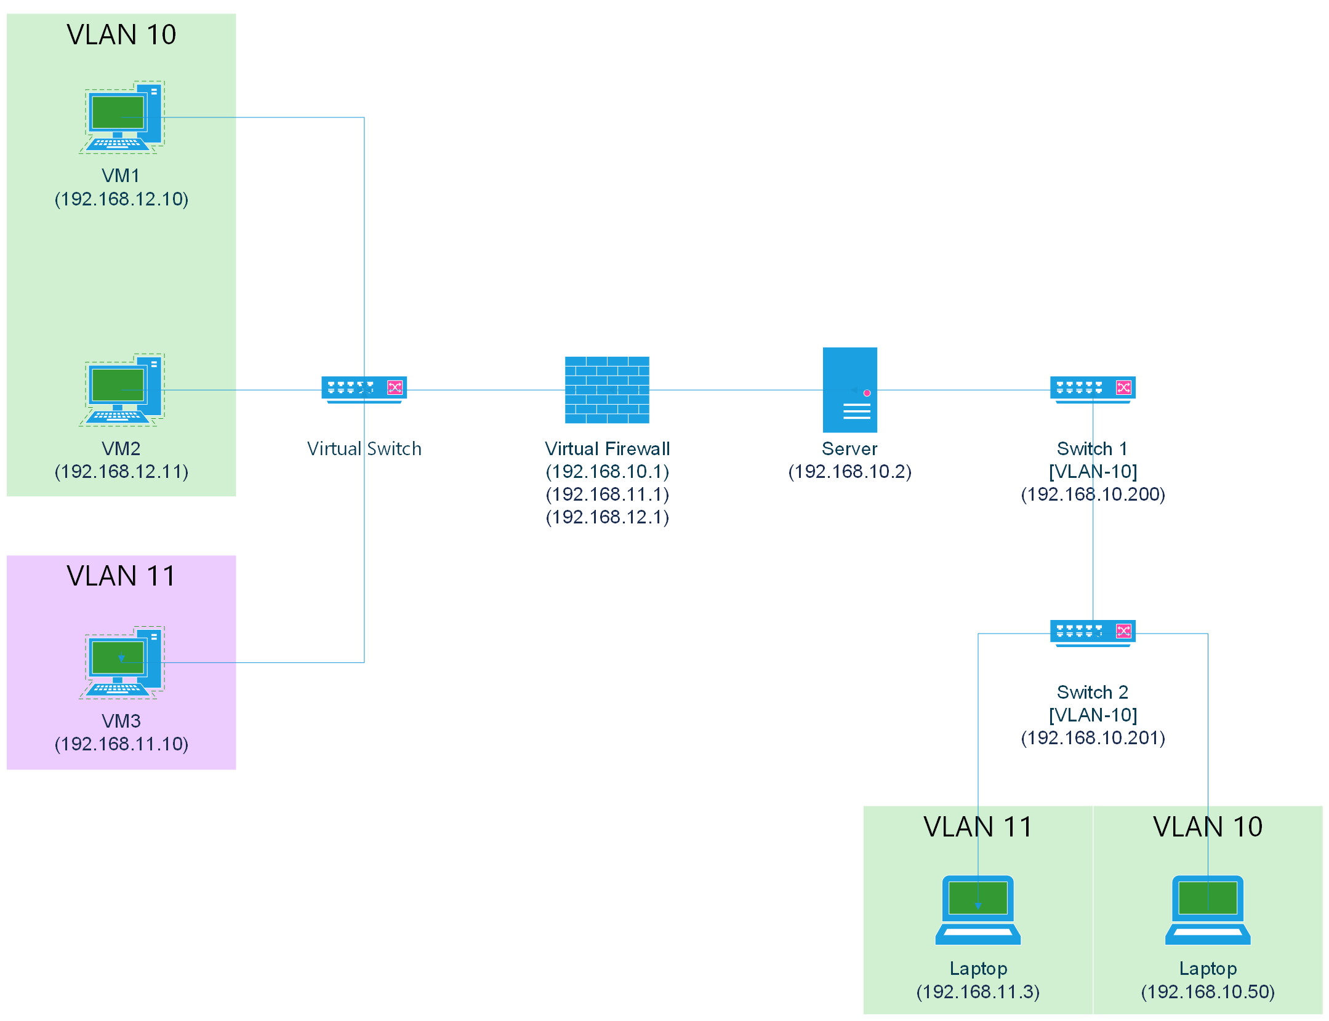
03-Adding_A_Server_To_A_Network
This was one of the biggest tasks I had received. It involved reloading a server, installing the OS for the server, create (at least) 3 VMs, setup a firewall and set up some networks and facilitate communication between them.

Slide 14
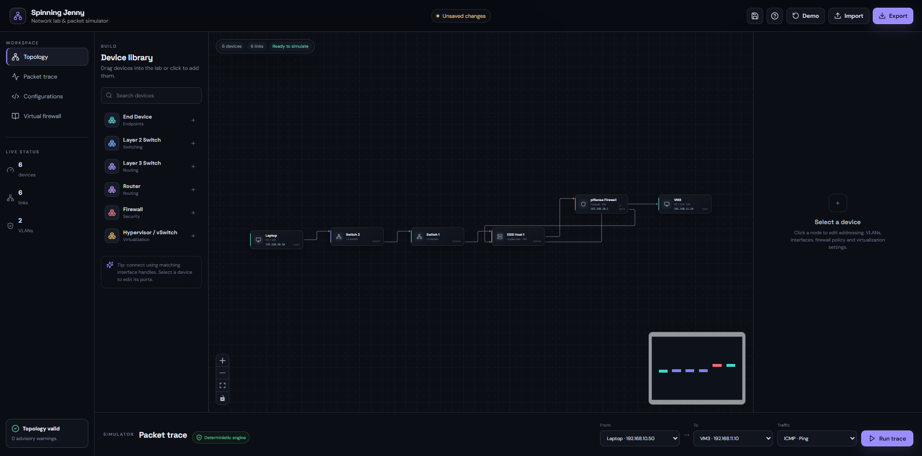
Spinning Jenny
What inspired this program, was the fact that I struggled with making my networks communicate because I didn’t understand how to configure the firewall properly, I eventually did but I didn’t want to struggle like that ever again.
I decided to make Spinning Jenny, to a help me quickly plan out a network, how it’s connected and the network(s) a device is on and how they communicate with one another.
Could I just do this in Packet Tracer? Yes, but where’s the fun in that?
I’m kidding, you could think of this as a more simplified quick Packet Tracer alternative.
Besides, I wanted to see if I make it…

Slide 15
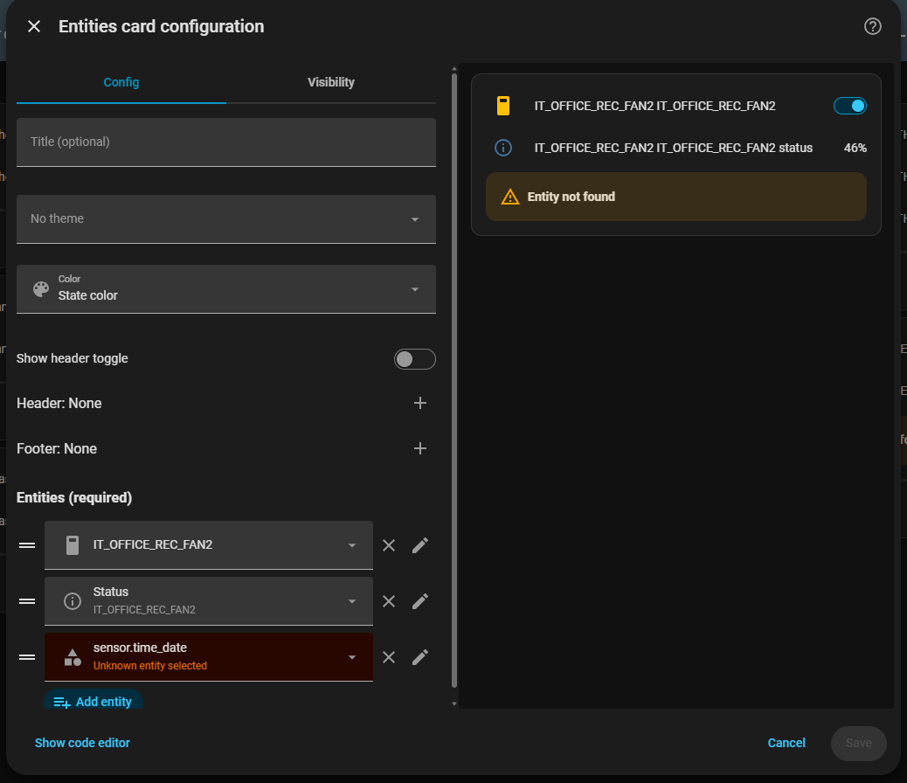
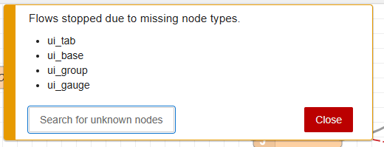
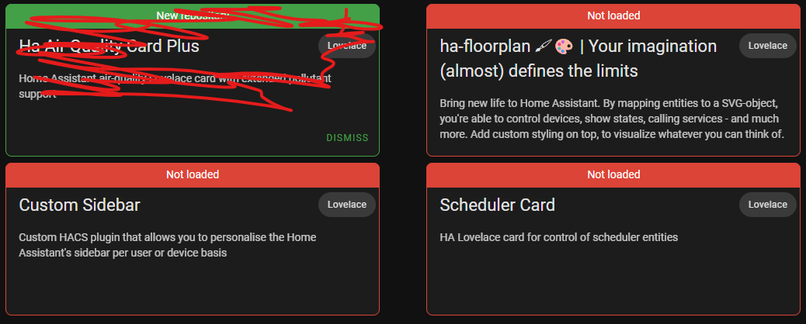
04-Home_Assistant
This task is an ongoing task, where I look for issues and resolve them, updating any software and fixing old Node-RED configurations.

Slide 16
05-Setting_Up_A_Thin_Client
This is the first task where I did work that wasn’t for practice purposes.
Task Breakdown:
Decide on its name and label it with the name and IP address.
Once booted up, switch to Administrator mode.
Give them static IP addresses on the 192.168.193.0 network.
Give them names following the naming convention.
Setup VNC.
Ping the Gateway 192.168.193.1.
Go to the Ignition server 192.168.193.2:8088.
Go to Perspective -> Launch -> then on CCL2 SCADA Project (the first one), launch it.
Once it's loaded, you'll see the Process section on the right side; choose the corresponding process to the device name you are configuring.
Once you enter that process, copy the link and set the browser to do the following:
  When the user clicks on the browser, it should lead to the copied link from the process.
  Rename the browser to CCL2-[Process Name].
  Enable Kiosk, and disable all the sub-options.
  Remove Features: Tabbing, Home Button, Back/Forward Button.
  Set the browser to auto-connect so it starts up immediately when it's closed, or when the PC boots up.

Slide 17
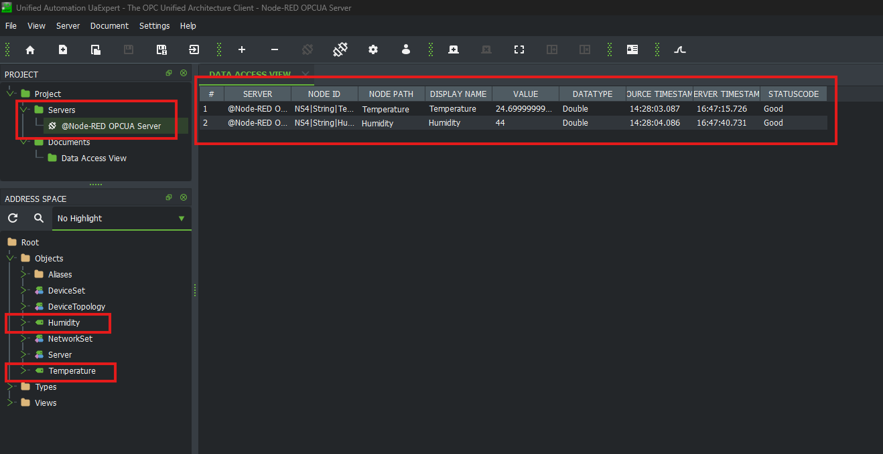
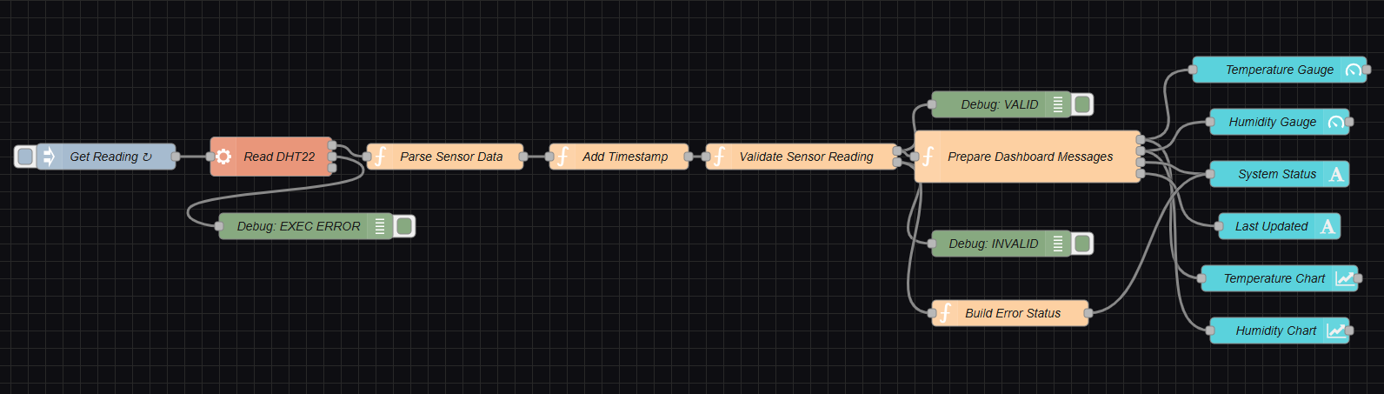
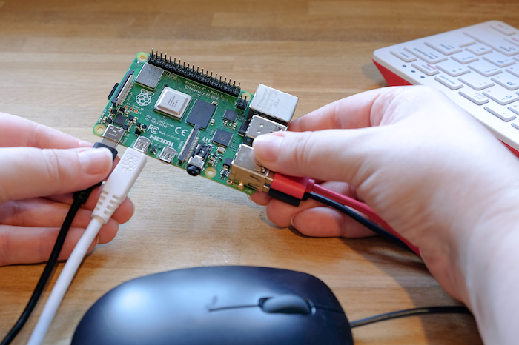
06-Raspberry_Pi_Configuration
This task was the most “fun”, it had 3 parts to it:
Setting up and configuring the Raspberry Pi for both desktop and remote access and attaching a Temperature and Humidity sensor.
Setting up Node-RED and configuring the sensor use Node-RED.
Setting up a OPC UA Server to read data from the sensor.

Slide 18
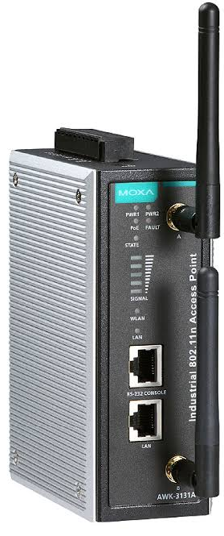
07-Setting_Up_Access_Points
A HMI was connected to the commercial network instead of the OT network. This does not align with OT network segmentation requirements.
This task was replacing the existing wireless bridge between the HMI and the OT network,
I configured a switch, 2 moxa Access Points and shadowed my mentor in the plant and also set up the access points along with the switch.

Slide 19
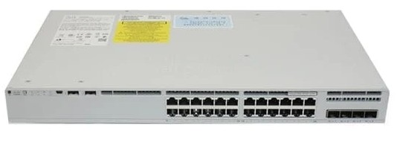
08-Switch-Configuration
Back to the basics? No, this task involved me having to reset 2 already configured switches and reconfigure them following a reference configuration
This is not a configuration task (entirely) for learning purposes, this was and will probably be the hardest configuration I will encounter and every idea explored is a concept worth exploring further.

Slide 20
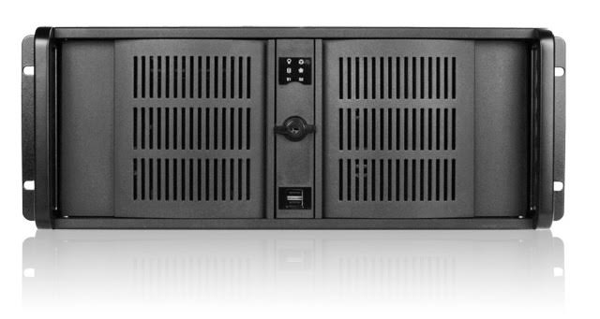
09-Server_Diagnoses
A shadow task, my mentor and I went to receive a server that was said to not be working. After close inspection, the servers’ power pins were disconnected from the motherboard. Aside from that there were several issues, and in the end, we decided to backup the Hard Drive and replace the server
This was my first task touching legacy systems and activating Windows XP, installing the necessary drivers.

Slide 21

Mapping out the Hulamin OT network

Slide 22

Holly Bibley
Holly Bibley is your network topology mapping application — a tool you're developing to help network engineers visually design, document, and eventually automatically discover network infrastructure.
The original idea came from the way the my managers document physical and logical network infrastructure.
Instead of manually drawing network diagrams in Visio, Holly Bibley aims to provide a dedicated application for designing and managing network topologies. It is especially useful for documenting a network visually.

Slide 23
Thank you

